Slide 1
SeqOccIn 2021
Axis 1 – Diploid Assembly
Andreea Dreau
Arnaud Di Franco
Clément Birbes

Slide 2
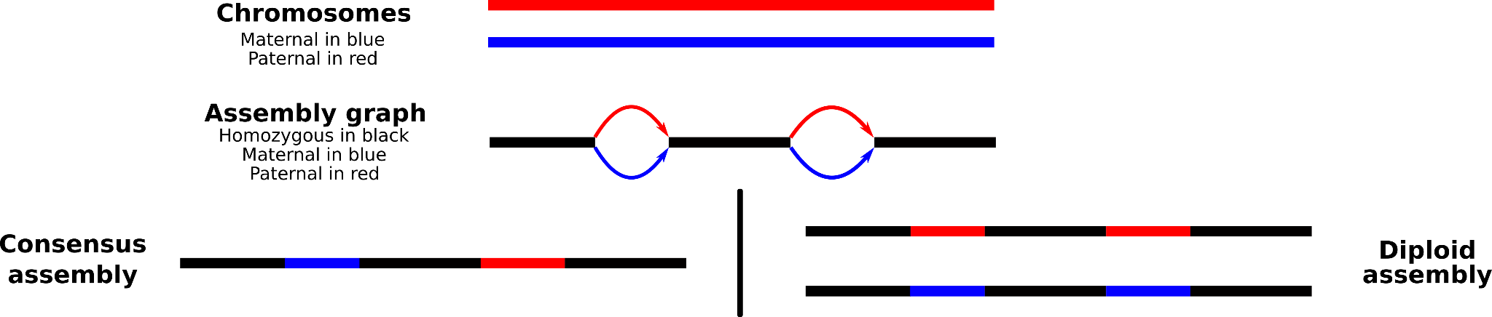
Diploid Assembly
A diploid assembly is an assembly in which the maternal and paternal haplotypes are separated to create 2 sets of chromosomes.
Different methods exists to create a diploid assembly.
1 Method using distant connection to separate haplotypes
1 Method resolving haplotype based on parental K-mer
1 Method using long reads only

Slide 3
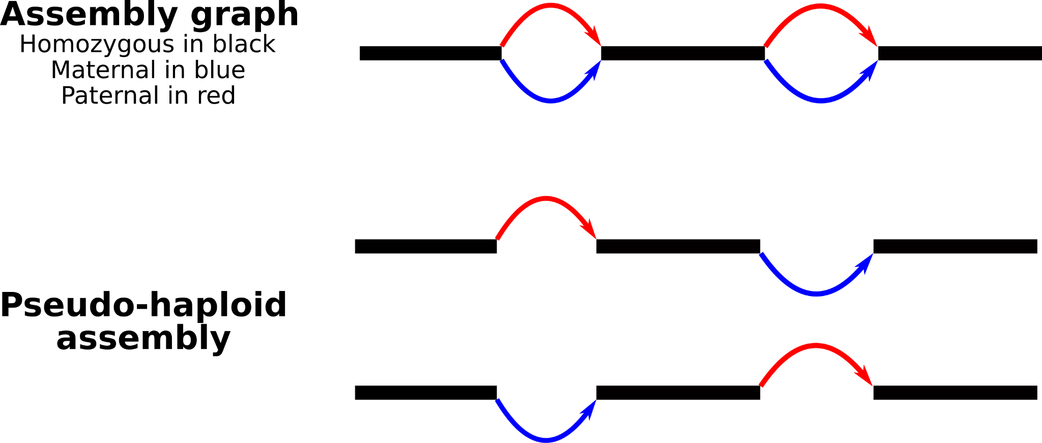
Hifiasm Diploid Assembly
Produce diploid assembly using HiFi reads (long reads with low error rate) and separate haplotype with heterozygous regions informations.
HiFi
Offspring
HiFiasm
Haplotype1
Haplotype2
This method produces chimeric assemblies due to the lack of information in some intra-chromosome areas but also between chromosomes

Slide 4
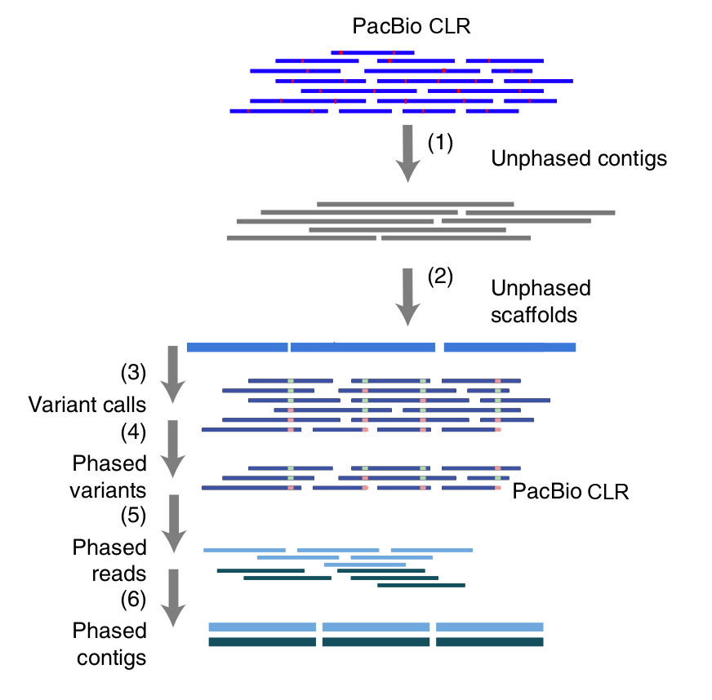
Long Reads phasing
A third way to separate haplotypes is through phasing, using SNPs
+
No parental information needed
No supplementary sequencing
-
Affected by numerous factors
SNP density
Reads length distribution
Reads quality
...
Long reads are particularly useful as their size allow for large phased blocks
Protocol based on DipAsm proof of concept (Garg et al. 2020) and adapted for long reads only
( )
LongShot (HapCut2 ML)
HapCut2 (&& WhatsHap phase)
WhatsHap haplotag
Hifiasm
This method produces chimeric assemblies due to the lack of information in some intra-chromosome areas but also between chromosomes

Slide 5
Hifiasm-HiC Diploid Assembly
Produce diploid assembly using HiFi reads (long reads with low error rate) and Hi-C connection information to separate haplotypes
HiFi
Offspring
Hi-C
Offspring
HiFiasm
Haplotype1
Haplotype2
This method produces chimeric assemblies due to the lack of Hi-C contact in some intra-chromosome areas but also between chromosomes

Slide 6
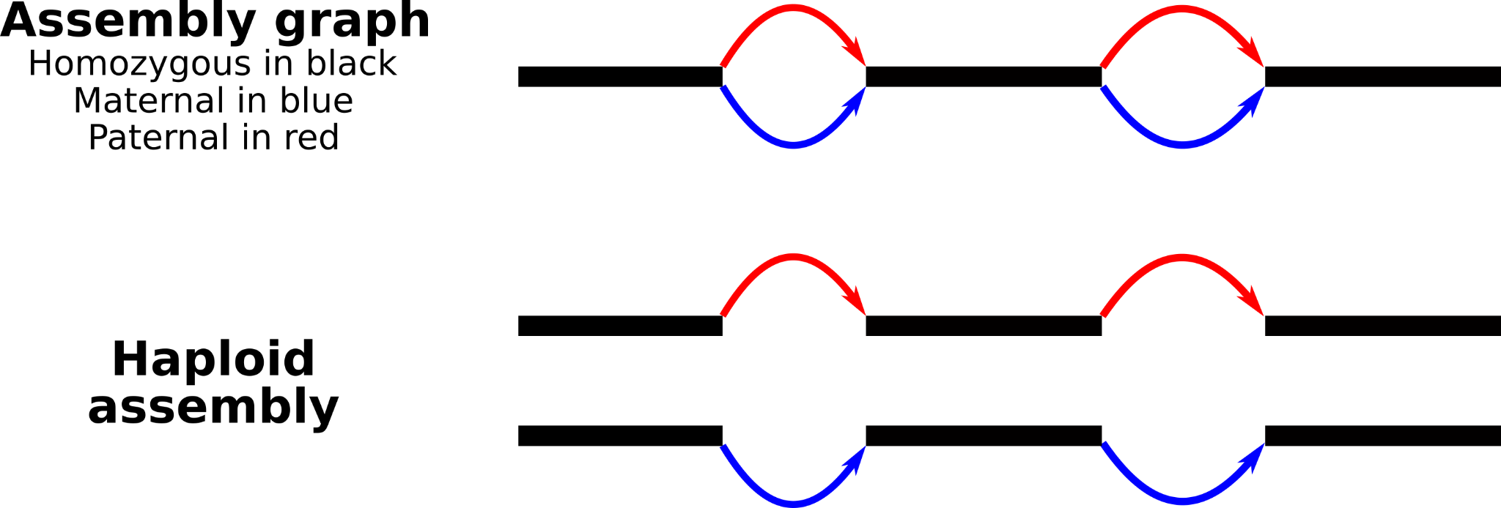
Hifiasm-Kmer Diploid Assembly
Produce diploid assembly using HiFi reads (long reads with low error rate) and parental short reads to separate haplotypes
Mother
Short reads
Father
Short reads
HiFi
Offspring
K-mer
Mother
K-mer
Father
HiFiasm
This method produces better diploid assemblies with fewer haplotyping errors through the use of parental kmers
Mother
Haplotype
Father
Haplotype

Slide 7
Diploid Assemblies Statistics
Données | CCS |  |  | CCS_Haplotag |  | CCS_Haplotag_Split |  | CCS/HiC |  | CCS_Yak
Quantité | 31X |  |  | 31X |  | 31X |  | 31X+28X |  | 31X+2x80X
Assembleur | Hifiasm |  |  | Hifiasm |  | Hifiasm |  | Hifiasm_HiC |  | Hifiasm_Yak
 | Consensus | Hap1 | Hap2 | Hap1 | Hap2 | Hap1 | Hap2 | Hap1 | Hap2 | Hap1 | Hap2
Number of contigs | 1 444 | 2 173 | 2 241 | 2 582 | 2 701 | 3 773 | 3 009 | 2 658 | 2 136 | 2 871 | 2 300
Total size (Gb) | 3.244 | 3.175 | 3.087 | 3.214 | 3.208 | 3.455 | 3 .61 | 3.078 | 3.184 | 3.2 | 3.1
Longest contigs (Mb) | 158.4 | 158.4 | 159.4 | 132.5 | 159.1 | 159.6 | 158.3 | 159.8 | 159.2 | 158.6 | 159.2
N50 contigs length (Mb) | 84.1 | 73.6 | 80.6 | 43.1 | 46.2 | 63.2 | 68.5 | 80.1 | 71.6 | 71.6 | 69.1
BUSCO | C:95.9% | C:95.7% | C:95.9% | C:95.4% | C:95.5% | C:95.8% | C:95.7% | C:95.7% | C:95.8% | C:95.8% | C:95.3%

Slide 8
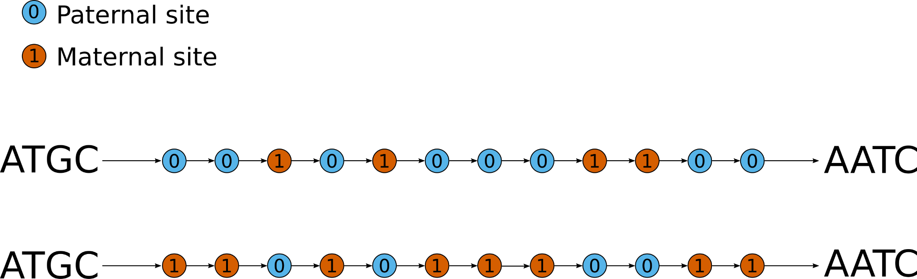
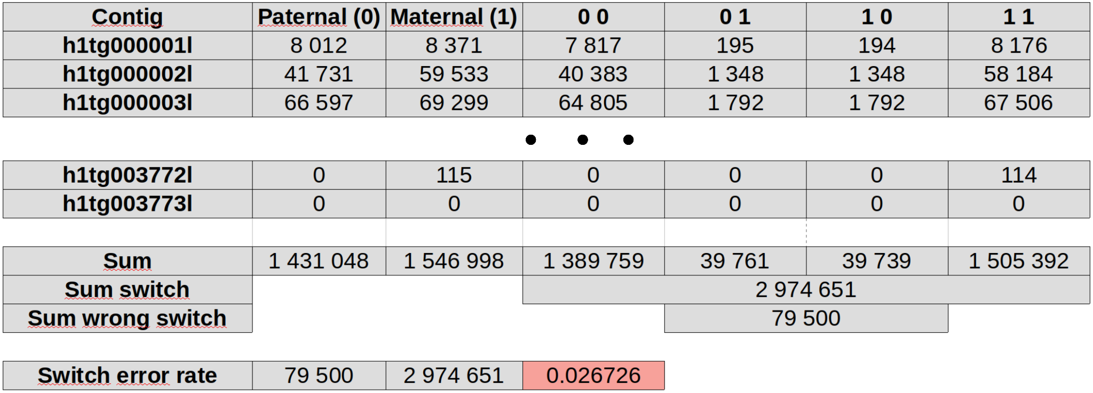
Diploid Assemblies - Yak.trioeval
 | Yak | HiC | SV | Simple
Switch Hap1 | 0.028582 | 0.030709 | 0.026726 | 0.027277
Switch Hap2 | 0.026800 | 0.024790 | 0.026206 | 0.028217
Hamming Hap1 | 0.027533 | 0.035184 | 0.351140 | 0.376557
Hamming Hap2 | 0.028670 | 0.023762 | 0.349655 | 0.383939

Slide 9
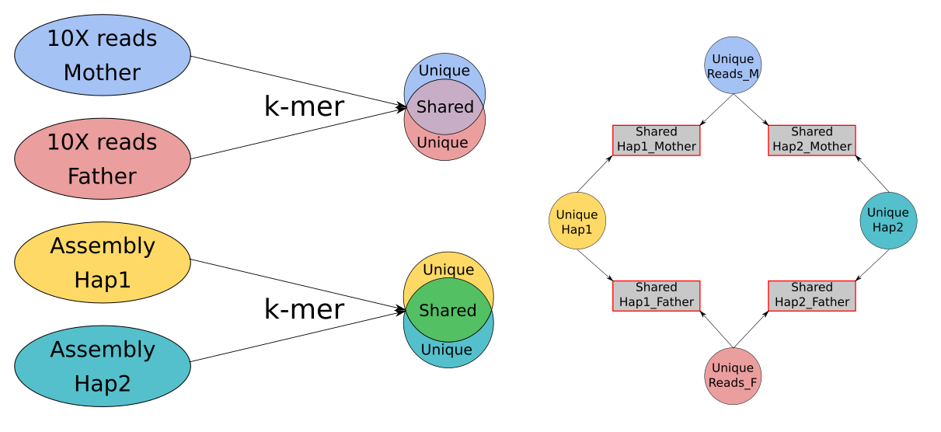
Diploid Assemblies - Kmer
Are produced haplotypes well-separated ?
Protocol based on k-mer to assess the haplotyping quality:
Extract a list of all k-mers from parental reads (Reads_M and Reads_F) and assembled haplotypes (Hap1 and Hap2)
Extract unique k-mers from Reads_M, Reads_F, Hap1 and Hap2
Compare Shared Unique k-mers between each pair Reads-Hap

Slide 10
Diploid Assemblies - Kmer
 | Simple | DipAsm | Trio_Yak | HiC
Uniq 37161 (Father) | 211 306 159
Uniq 37162(Mother) | 190 003 623
Uniq Hap1 | 68 127 607 | 65 177 035 | 75 122 750 | 67 672 898
Uniq Hap2 | 66 389 188 | 63 610 620 | 68 786 188 | 68 174 024
Uniq Shared 37161 Hap1 | 15 644 523 | 16 224 181 | 159 521 | 12 513 350
Uniq Shared 37161 Hap2 | 17 557 070 | 16 076 371 | 33 337 798 | 21 004 304
Uniq Shared 37162 Hap1 | 18 411 760 | 16 179 561 | 34 054 852 | 21 078 367
Uniq Shared 37162 Hap2 | 15 409 073 | 15 693 869 | 116 586 | 13 021 761

Slide 11
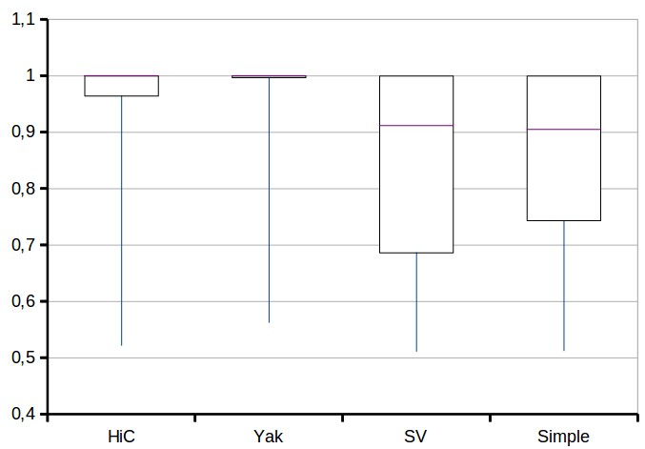
Diploid Assemblies - Kmer - 100 Contigs
 | Majority | Minority
Ctg1-1 | 100% | 0%
Ctg1-2 | 100% | 0%
Ctg2-1 | 75% | 25%
Ctg2-2 | 94% | 6%
 | 37161_Hap1 | 37161_Hap2 | 37162_Hap1 | 37162_Hap2
Ctg1 | 36 | 0 | 0 | 15
Ctg2 | 3002 | 1001 | 199 | 3171
 | HiC | Yak | SV | Simple
Min | 0.52 | 0.56 | 0.51 | 0.51
Q1 | 0.96 | 0.99 | 0.69 | 0.74
Mediane | 1 | 1 | 0,91 | 0,90
Q3 | 1 | 1 | 1 | 1
Max | 1 | 1 | 1 | 1

Slide 13
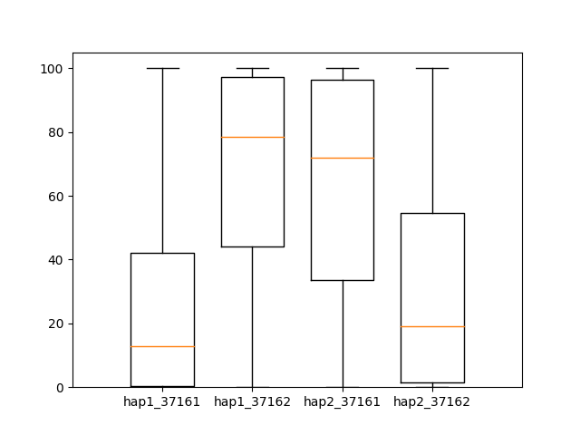
Haplotype separation evaluation for all contigs - YAK method
Global (all contigs) % of specific k-mers intersection :
- 37160 hap1 to 37161: 2.66 %
- 37160 hap1 to 37162: 97.33 %
- 37160 hap2 to 37161: 96.73 %
- 37160 hap2 to 37162: 3.27 %
% values of specificity per contig

Slide 14
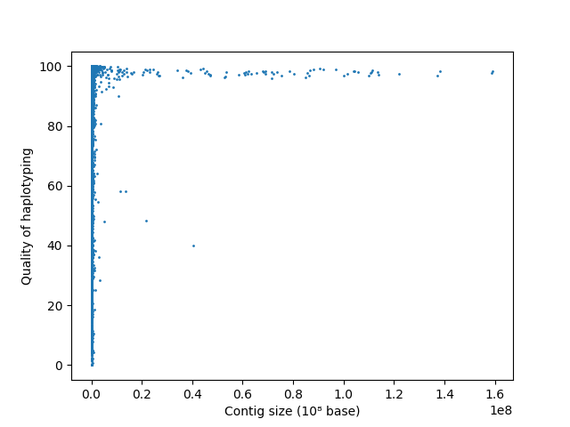
Haplotype separation evaluation for all contigs - YAK method
Global (all contigs) % of specific k-mers intersection :
- 37160 hap1 to 37161: 2.66 %
- 37160 hap1 to 37162: 97.33 %
- 37160 hap2 to 37161: 96.73 %
- 37160 hap2 to 37162: 3.27 %
% values of specificity per contig depending on the contig length
% values of specificity per contig

Slide 15
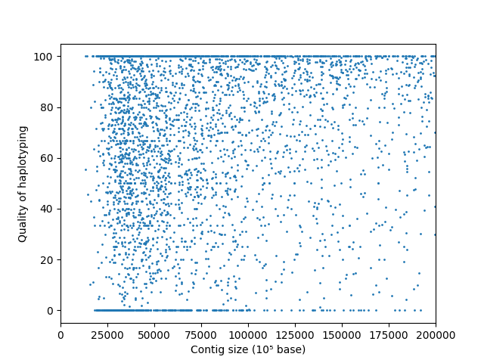
Haplotype separation evaluation for all contigs - YAK method
Global (all contigs) % of specific k-mers intersection :
- 37160 hap1 to 37161: 2.66 %
- 37160 hap1 to 37162: 97.33 %
- 37160 hap2 to 37161: 96.73 %
- 37160 hap2 to 37162: 3.27 %
% values of specificity per contig depending on the contig length
% values of specificity per contig

Slide 16
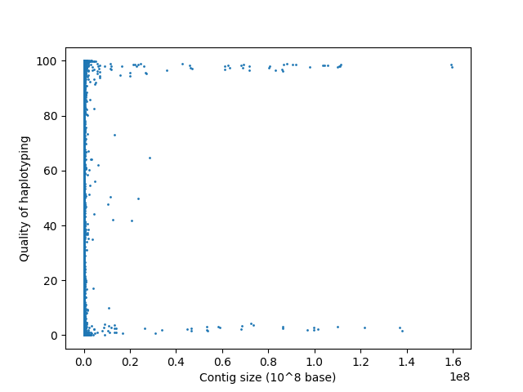
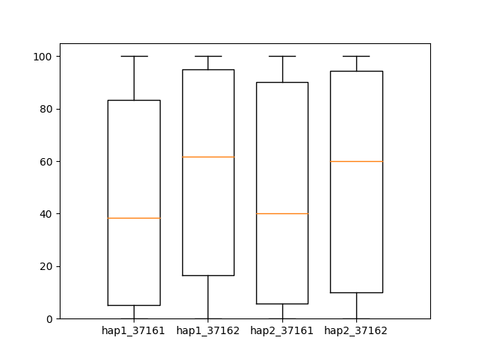
Haplotype separation evaluation for all contigs - HiC method
Global (all contigs) % of specific k-mers intersection :
- 37160 hap1 to 37161: 37.4 %
- 37160 hap1 to 37162: 62.59 %
- 37160 hap2 to 37161: 60.51 %
- 37160 hap2 to 37162: 39.48 %
% values of specificity per contig depending on the contig length
% values of specificity per contig

Slide 17
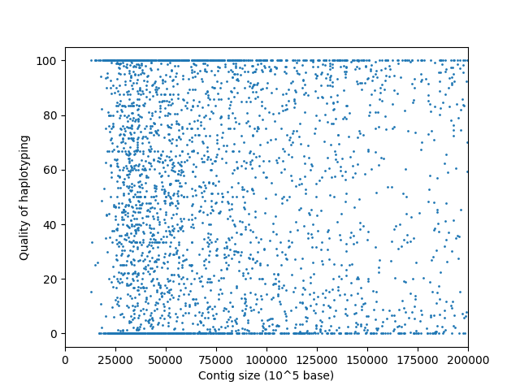
Haplotype separation evaluation for all contigs - HiC method
Global (all contigs) % of specific k-mers intersection :
- 37160 hap1 to 37161: 37.4 %
- 37160 hap1 to 37162: 62.59 %
- 37160 hap2 to 37161: 60.51 %
- 37160 hap2 to 37162: 39.48 %
% values of specificity per contig depending on the contig length
% values of specificity per contig

Slide 18
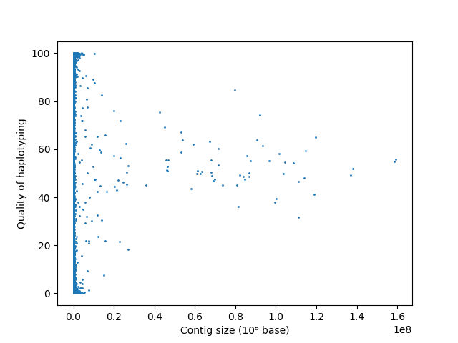
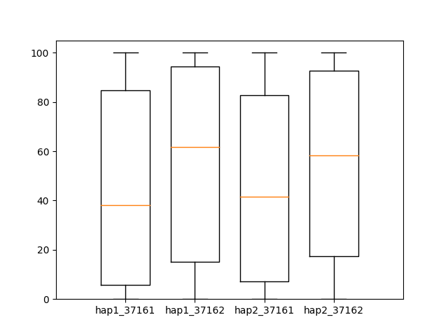
Haplotype separation evaluation for all contigs - Simple method
Global (all contigs) % of specific k-mers intersection :
- 37160 hap1 to 37161: 45.66 %
- 37160 hap1 to 37162: 54.33 %
- 37160 hap2 to 37161: 52.47 %
- 37160 hap2 to 37162: 47.52 %
% values of specificity per contig depending on the contig length
% values of specificity per contig

Slide 19
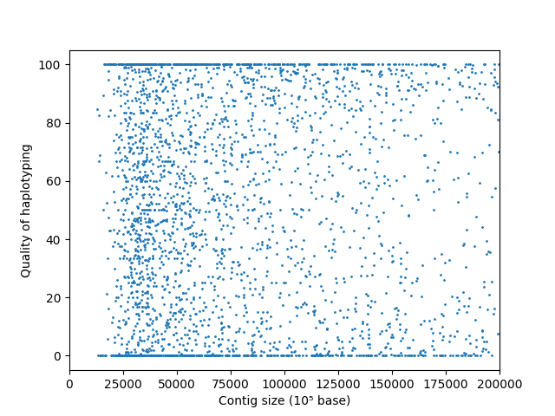
Haplotype separation evaluation for all contigs - Simple method
Global (all contigs) % of specific k-mers intersection :
- 37160 hap1 to 37161: 45.66 %
- 37160 hap1 to 37162: 54.33 %
- 37160 hap2 to 37161: 52.47 %
- 37160 hap2 to 37162: 47.52 %
% values of specificity per contig depending on the contig length
% values of specificity per contig

Slide 20
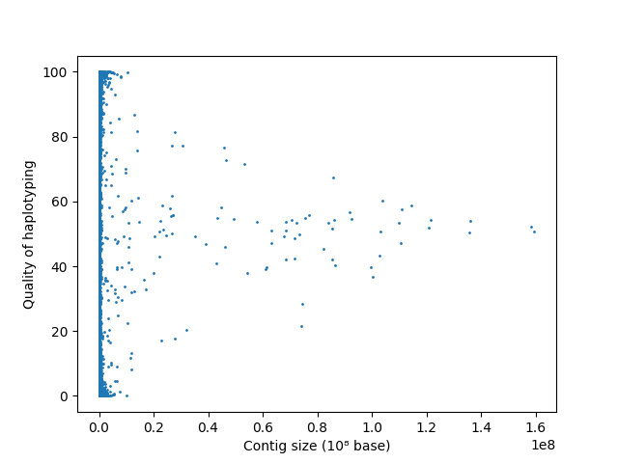
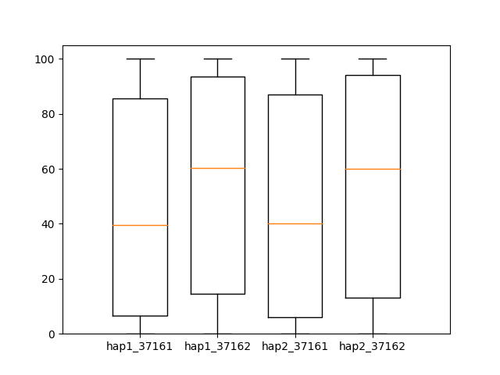
Haplotype separation evaluation for all contigs - SV method
Global (all contigs) % of specific k-mers intersection :
- 37160 hap1 to 37161: 47.87 %
- 37160 hap1 to 37162: 52.12 %
- 37160 hap2 to 37161: 48.24 %
- 37160 hap2 to 37162: 51.75 %
% values of specificity per contig depending on the contig length
% values of specificity per contig

Slide 21
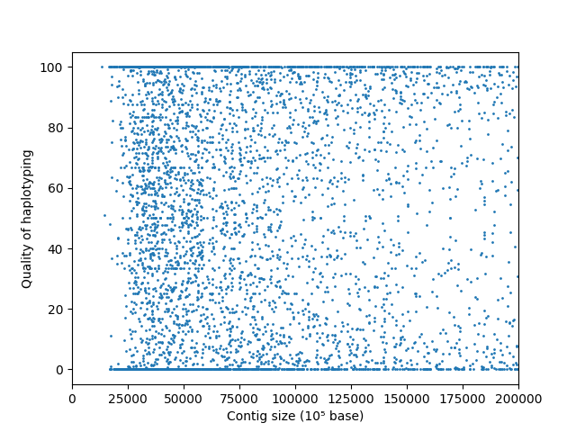
Haplotype separation evaluation for all contigs - SV method
Global (all contigs) % of specific k-mers intersection :
- 37160 hap1 to 37161: 47.87 %
- 37160 hap1 to 37162: 52.12 %
- 37160 hap2 to 37161: 48.24 %
- 37160 hap2 to 37162: 51.75 %
% values of specificity per contig depending on the contig length
% values of specificity per contig

